Slide 1
The Evolution of
Employee Advocacy
Stuart Jones
Founder
InSource Talent

Slide 2
Harness your Employee Voices for Employer Brand Activation
Having a strong Employer Brand undoubtedly gives your company a competitive advantage when recruiting. Halving your cost-per-hire, doubling your hiring speed, and a 50% increase in qualified candidates are some of the reported outcomes. Whether you’re turned on by those kind of recruitment metrics or not, the fact remains: in a candidate-led recruitment market, the battle to recruit the best talent is often won or lost well before your recruitment team go to market with a new vacancy. If you have a weak employer brand, you’re fighting an uphill battle when the time comes to recruit.
Power to your People
Now, more than ever before, people are buying from people – not companies. Just think about the way we trust consumer reviews on Amazon, TripAdvisor, Airbnb, Glassdoor etc. It’s reported that 80% of people trust individuals over companies.
Not only that, while company updates have dropped to the bottom if the timeline, personal posts are being prioritised. This is currently the case across LinkedIn, Facebook & Instagram.
So, whether you like it or not, if you want to succeed in the current social landscape (with or without additional PPC budgets) you need to harness the power of your employee voices. Reports from companies with advocacy programmes in place suggest that even a small team of ‘advocates’ across the business can deliver 10X reach on social media.
Follow the slides and use the supporting notes for a step-by-step guide to WHY employee advocacy is on the rise, and HOW you can take your employees on the ‘Advocate Journey’. ☺

Slide 3
THE CASE FOR
EMPLOYEE ADVOCACY
‘The Rise of Employee Voices’

Slide 4
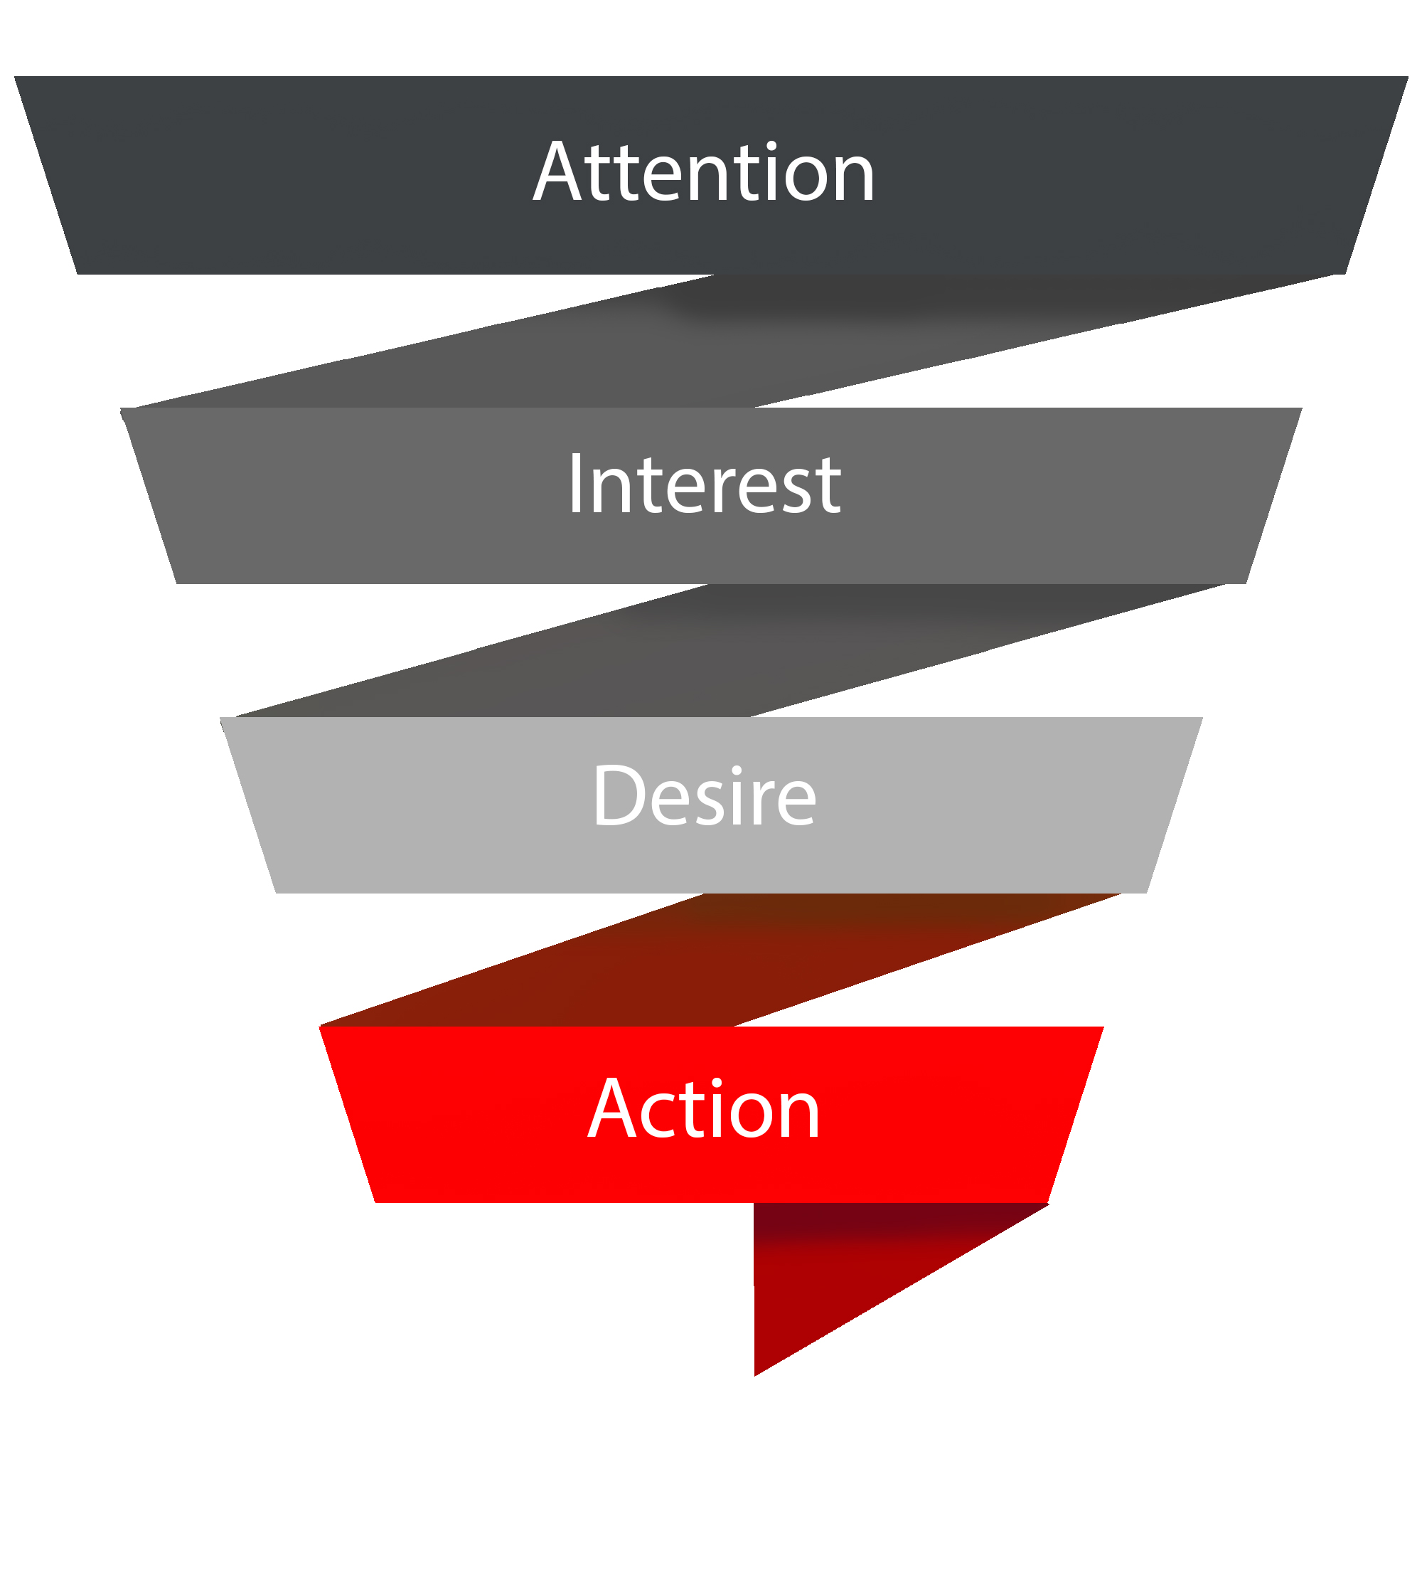
Modern Recruiting: Need for Content
Pre-Application Journey
(Content Funnel)
Active
Talent Pools
(Jobs / Life)
Vacancy Advertising
(Jobs)
Talent Pools
(Jobs / Life)
=
Reactive
(Current)
Proactive
(Future)
Pipeline / Branding
(Life / Interest)
Candidate Sourcing
(Jobs)
Pipeline / Branding
(Life / Interest)
Passive
Notes:
Notes for Matrix Model (Left-hand side)
This model plots the talent market against 2 axis – one showing active vs passive candidates, and the other showing current vs future hiring needs. The boxes in each quadrant represent the different hiring ‘tactics’ required to target talent in each sector (e.g. Advertising, to target Active Candidates for Current Vacancies, etc etc.)
The message this model provides for the topic of Employee Advocacy, is that if we want to target candidates for future vacancies, we need to share content that isn’t just Current Jobs. Future talent doesn’t care about our current vacancies (we don’t need them yet, or they’re not looking to move yet) – so it places a demand on the business / TA function to source content that talks about life at the business.
Pre-Application Journey (Content Funnel)
This funnel represents the stages of the modern candidate journey (pre-application). Based on the traditional AIDA model used in marketing for decades, it allows us to understand the stages of ‘discovery’ a given candidate might go through before they become an active candidate in our process:
Awareness – content that first makes them aware of us as a business (or maybe as an employer)
Interest – content that first makes them consider us as an employer
Desire – content that makes them want to work for us (maybe in a specific capacity)
Action – content that makes them apply to work for us / contact us about opportunities
By understanding these stages, we can begin to understand where we have content gaps in our funnel (and plan to fill them!)
Employee Advocacy can be positioned as part of the solution for creating content to fill the funnel. Recruiters have jobs content to share. Corporate comms / marketing have polished content to share. Employer branding (if it exists) might even have polished employer brand content to share. But Employee Advocacy can create real life, day to day content, on an ongoing basis.

Slide 5
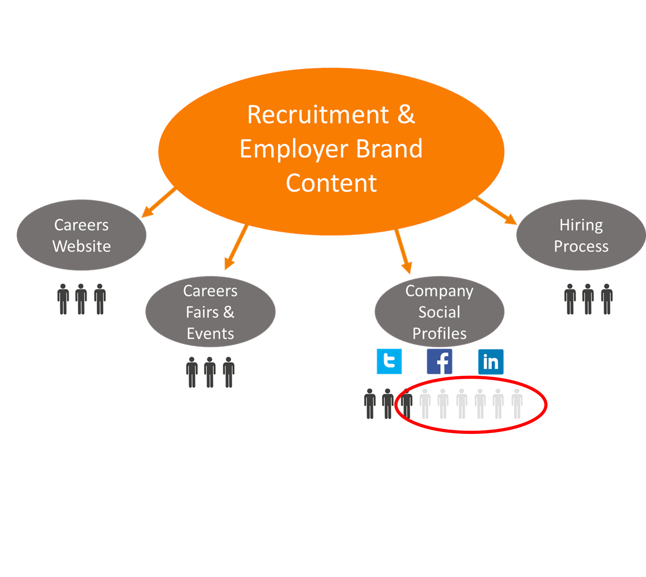
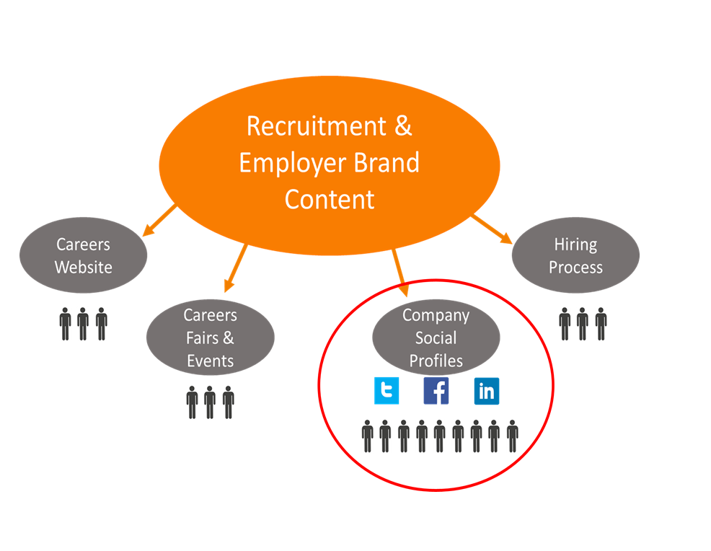
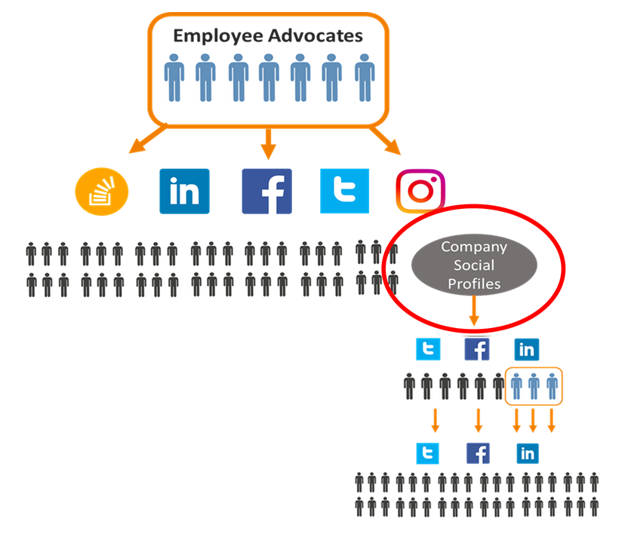
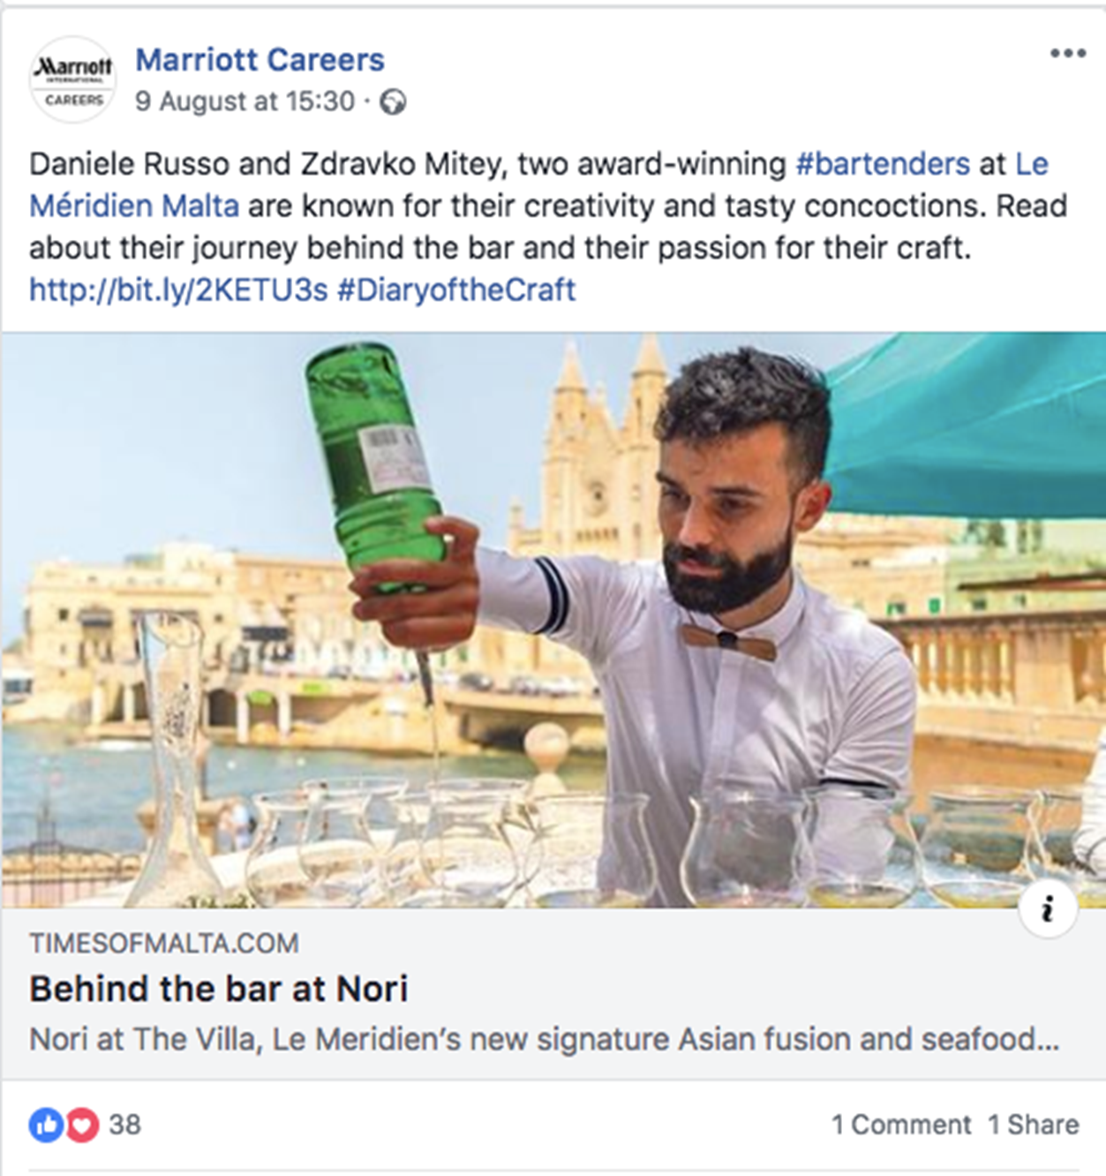
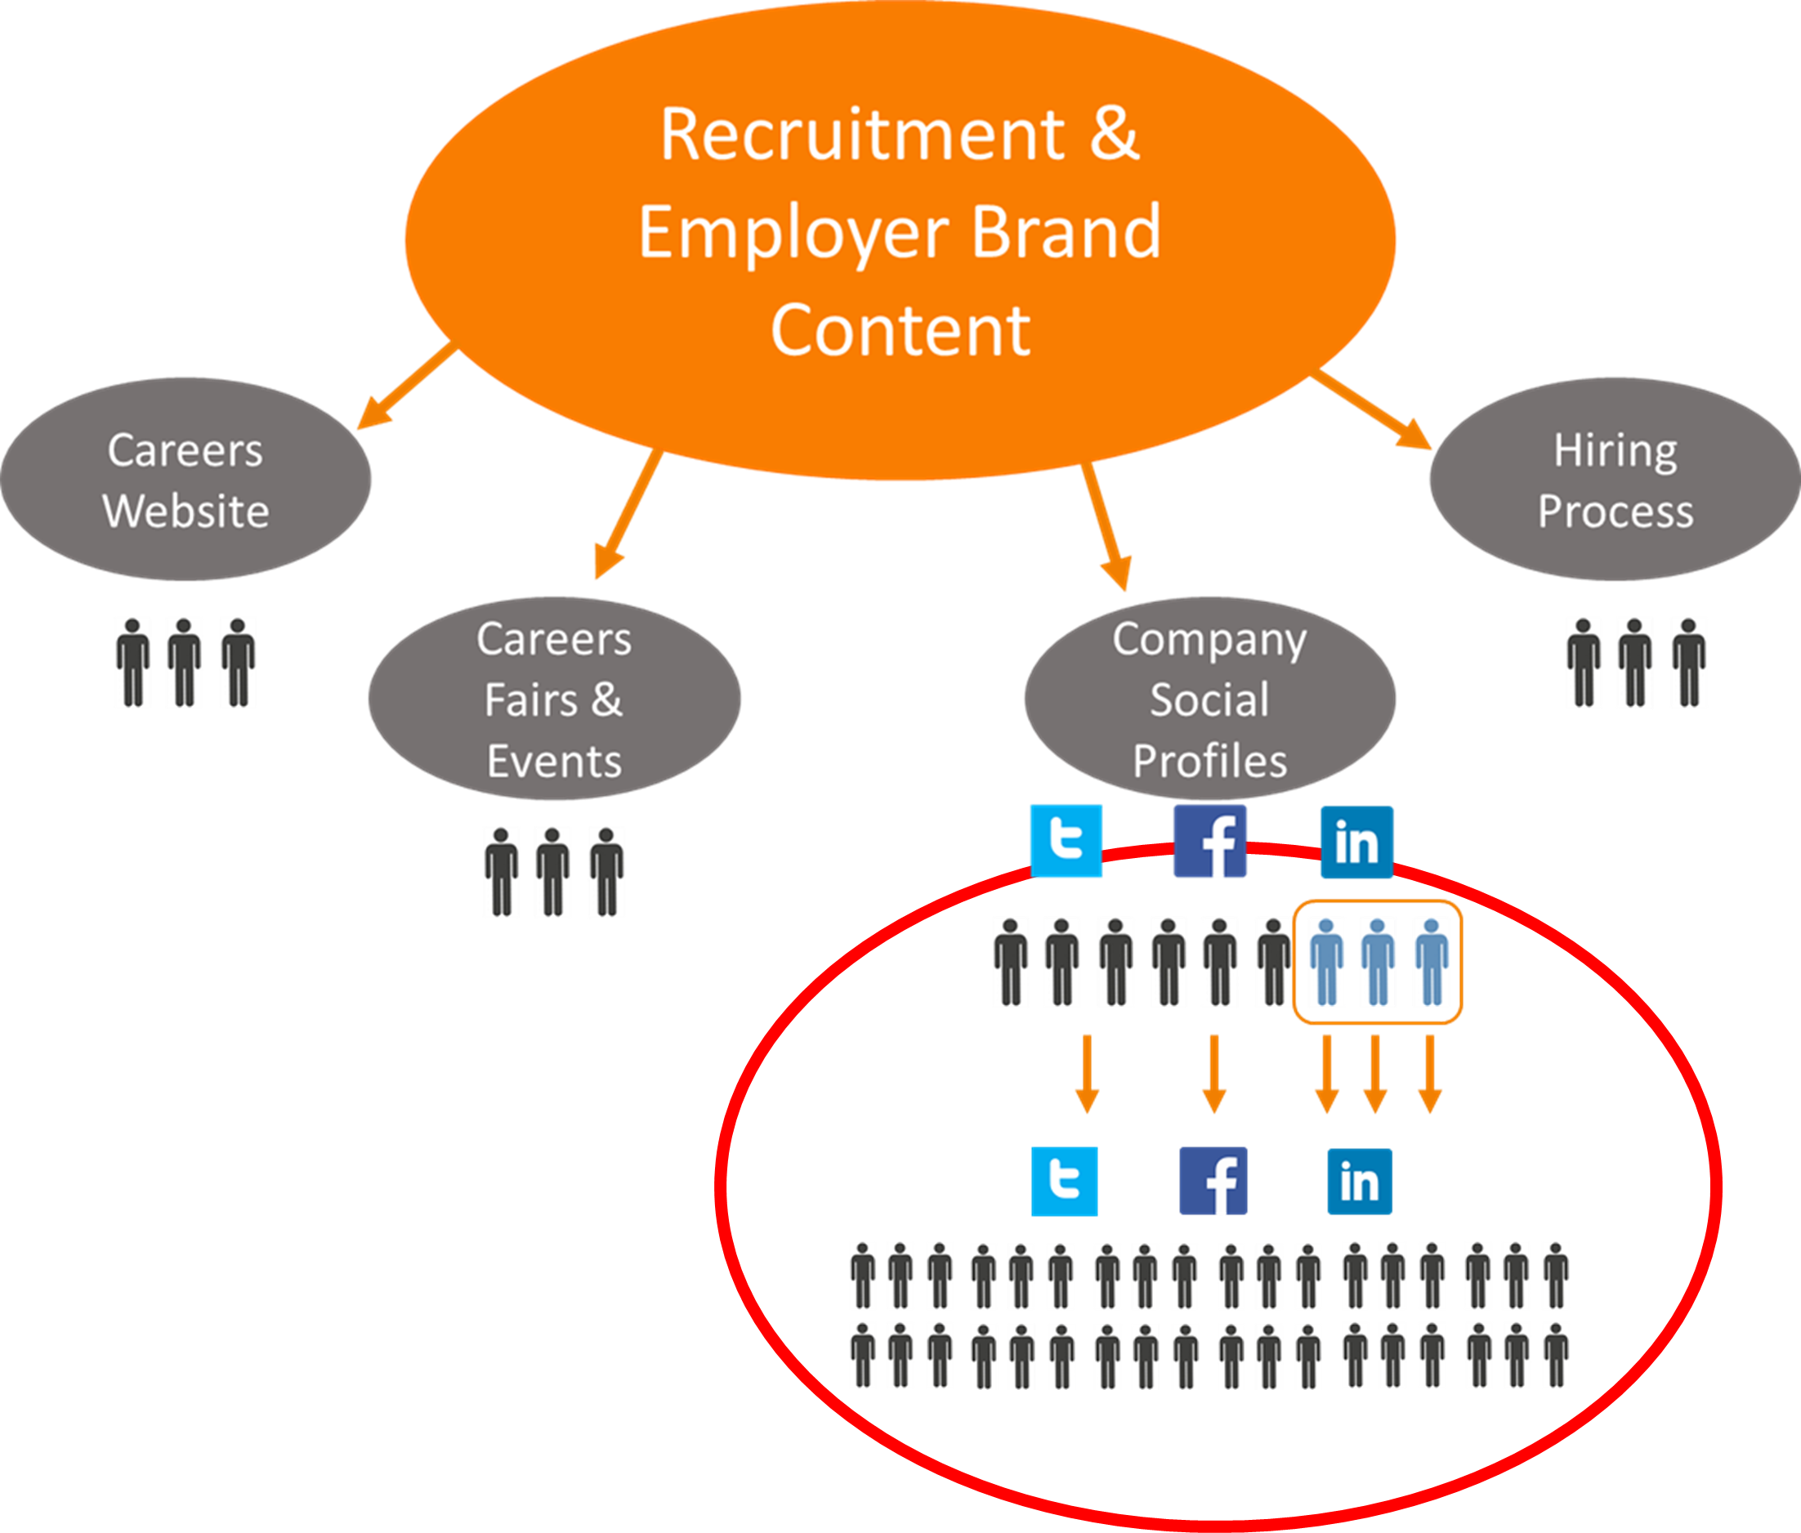
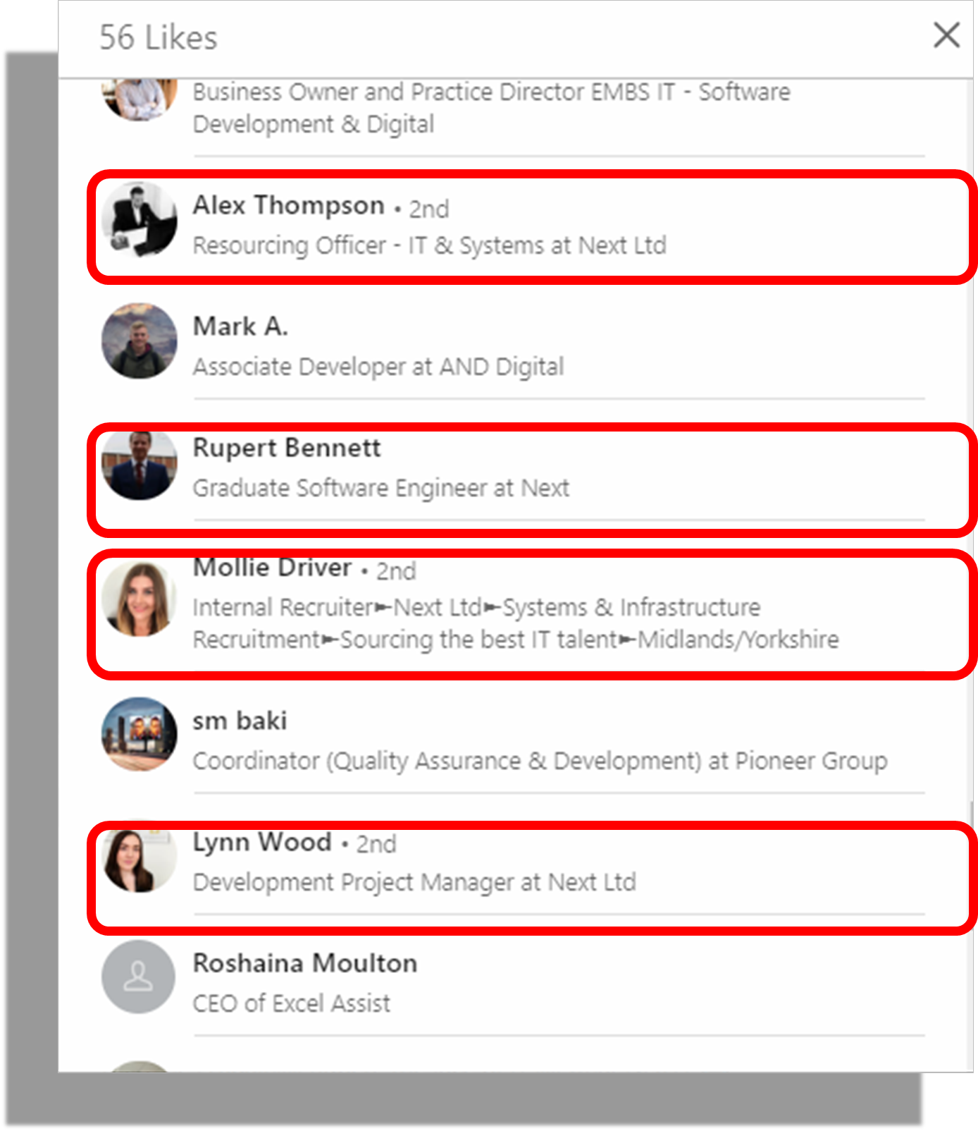
Shifting Social Media Landscape
EMPLOYEE ADVOCACY 1.0
REACH:
expand your audience by 561%
10 X company profile reach
90% new to the brand
ENGAGEMENT
Employee voices are 2X more trusted than corporations
EMPLOYEE ADVOCACY 2.0
CHALLENGES
W.I.F.M? Incentives?
Corporate content
CONTENT
EGC = authentic
Real time source (eyes & ears)
Employee Experience
= 0.0027% engagement
Notes:
Employee Advocacy Content Distribution (Left hand side)
Traditionally, the company controls the production and distribution of branded content – sharing initially to it’s own audience of followers, and encouraging it’s employees to engage with that contant to share it with their own networks. This model can be effective in generating organic reach – but can appear insincere and may create an ‘echo chamber’ effect.
An alternative, and improved version of the model, is to give your employees the skills and confidence to create their own content – and to share that directly with their own networks. The company pages on social then become part of the audience and like/share/repost that content back to the company’s followers – at which point it is likely to be liked/engaged/shared again by the employees who created it in the first place! This creates a virtuous upward spiral of organic reach and engagement (shown in the stats on the right)
And it’s not just reach, the message also has more impact coming from employee accounts than it does coming from the company page (2x more trustworthy according to the Edelman Trust Barometer)
It’s also better for the employee / advocate experience – being trusted to share their own voices, inside of simply being asked to share / regurgitate company content.

Slide 6
Cisco (#WeAreCisco)
Notes:
An example of Employee Advocacy 2.0 – Cisco / #WeAreCisco
All the images were originally shared by the employees from their own accounts, using a consistent hashtag. The company account simply monitors the hashtag and can create stunning collections of real-life employee images to share in this case from the company page.

Slide 7
Dell (#LifeAtDell)
Notes:
Dell / #LifeAtDell – simply have an ‘employee repost’ account on Instagram. All the images are credited to the original accounts who post them.

Slide 8
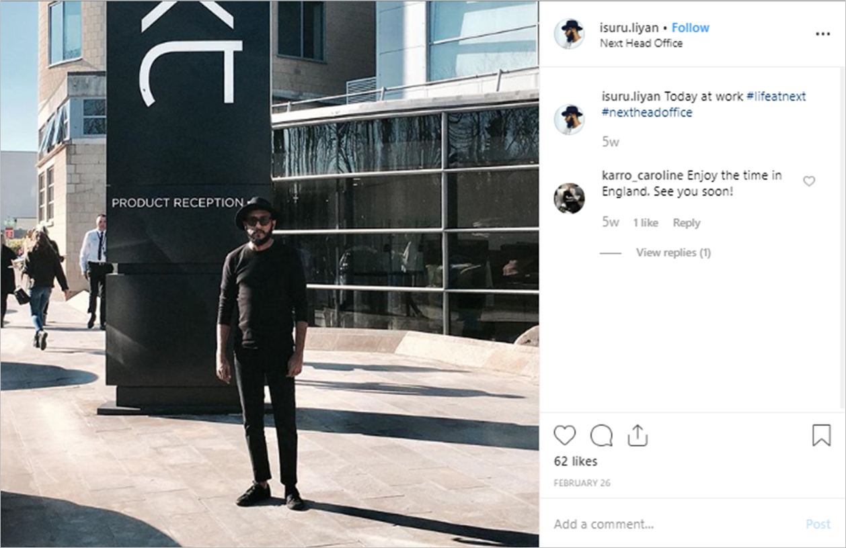
Next (#LifeAtNext)
#LifeAtNext
Notes:
Next / #LifeAtNext – images show a range of posts across different networks – the key to the strategy being the consistent use of the #LifeAtNext hashtag. This allows the company to monitor and reshare the best posts – or simply direct candidates to #LifeAtNext to see the company through the eyes of its’ employees.

Slide 9
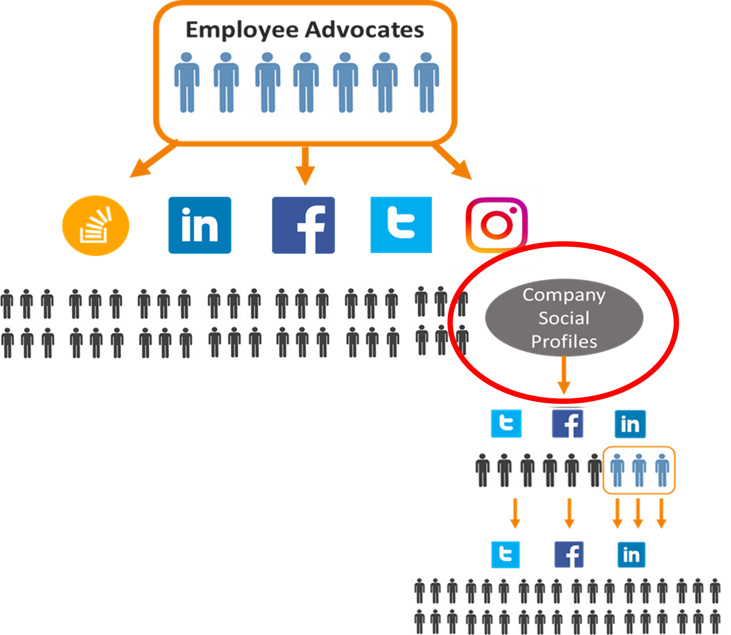
Which Model Are You?
0
1.0
2.0
Reach
Engagement
Corporate Content
Reach
Engagement
WIFM
Corporate Content
Reach
Engagement
Employee Experience
Employee Generated Content
Notes:
Question: which model does your company pursue currently?
0 – All content share through the company profiles, with organic reach (non-paid) throttled by the latest social network algorithms (company posts are deprioritised in the timeline)
1 – Employee Advocacy 1.0 – all content is shared through the company pages, but we have a programme in place to generate engagement from our employees to achieve more reach
2 – Employee Advocacy 2.0 – our employees play a role in content creation, sharing from their own accounts, and the company pages like/share/engage/repost selected content

Slide 10
THE ADVOCATE JOURNEY
‘Silent’ to ‘Brand Storyteller’

Slide 11
The Advocate Journey
Unfortunately, it’s not as simple as asking people to share company content – even if that message comes from senior leadership. Nobody wants to be seen as a corporate mouthpiece, robotically sharing company updates with their personal networks.
It’s important to recognise that there’s a journey for advocates to go on, and they’ll need support & training along the way.
You need to think about how you will:
• Give them a clear reason & purpose to engage
• Create relevant, interesting content for them to share
• Empower them with the authority, skills and confidence to identify, create & share their own workplace stories
Many of us assume, incorrectly, that our people are familiar with social media and understand how to engage appropriately on each platform. In reality, however, we’ve found that even the most confident social media users in their personal lives can lack confidence over what & when to share on a professional basis.

Slide 12
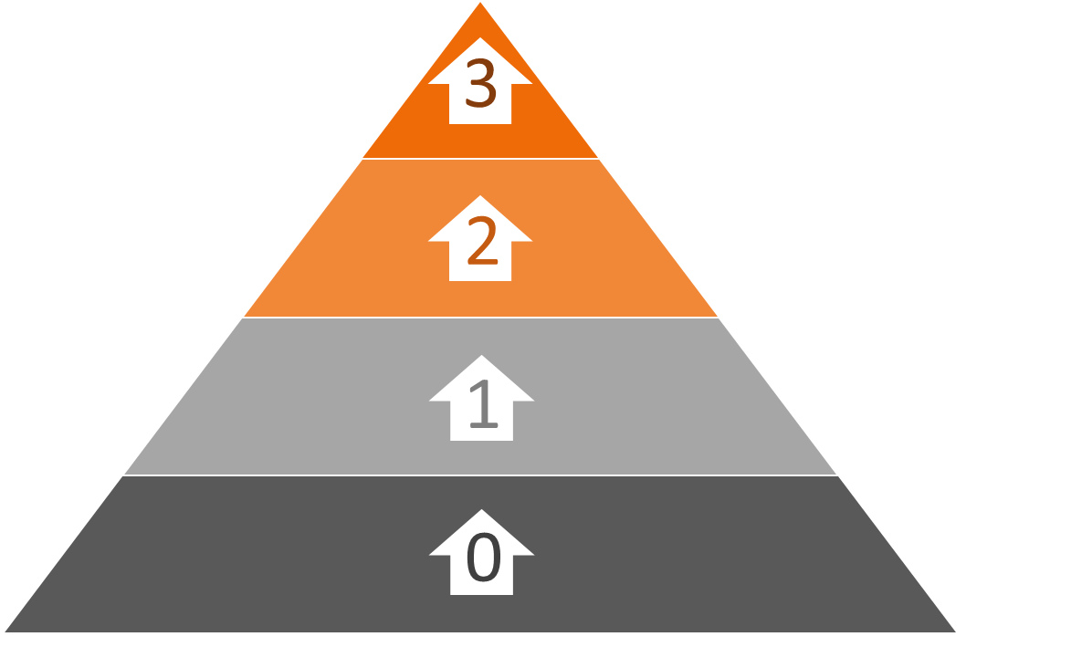
The Advocate Journey
Content Creation
Share & Engage
Brand Aligned
Organic / Inactive
Notes:
The Advocate Journey
These are the steps that an employee can follow on the advocate journey – to move from ‘silent’ to ‘storyteller’. It’s important to note that this journey should always be taken voluntarily (with encouragement!) and that any steps up from level 0 are advantageous to the business (and the individual).
Step One – Brand Alignment (profile & network development)
Step Two – Share & Engage (engaging with company / industry content)
Step Three – Content Creation (sharing their own workplace stories)
We’ll explore these more, with examples, in the following slides.

Slide 13
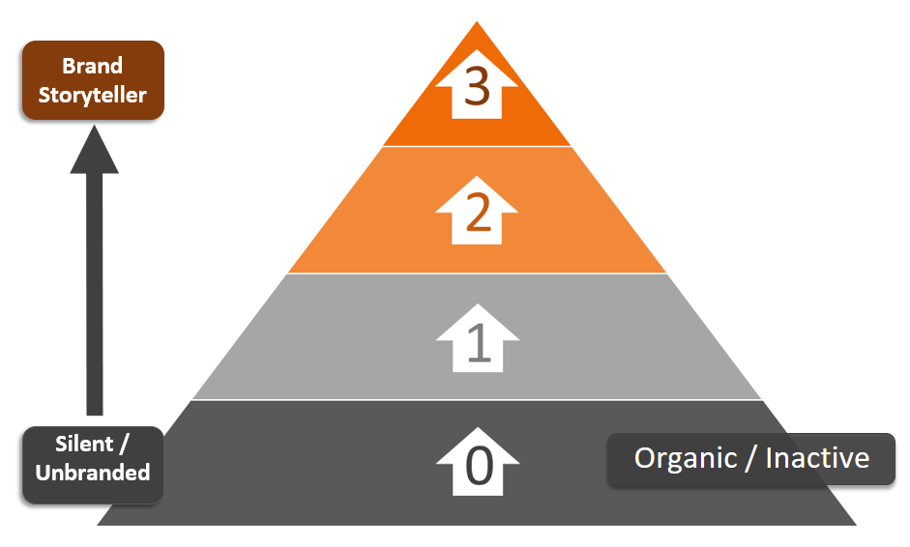
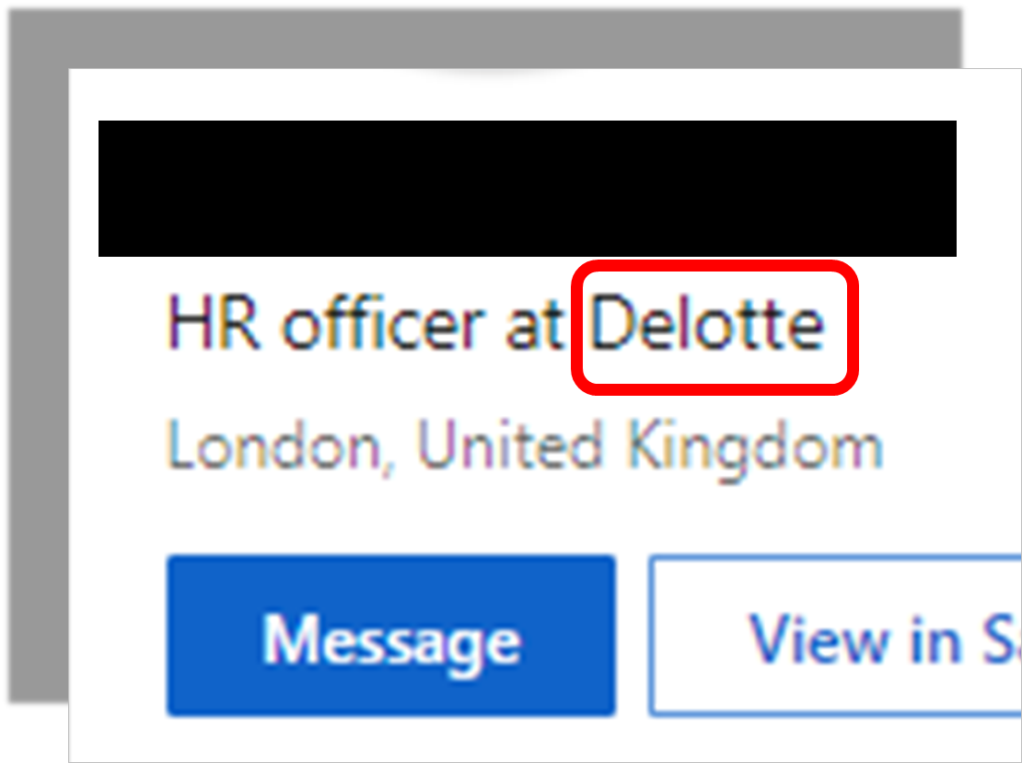
Level 0: Organic / Inactive
Characteristics:
Incomplete profile
Small / irrelevant networks
Not posting or engaging in brand content
Notes:
Level 0 – Organic/Inactive
At this stage, employee profiles remain incomplete, with small networks, and rarely engage with content.

Slide 14
Level 1: Brand Aligned
Characteristics:
Branded profile
Content aligned to audience
Links to corporate sites
Strategic network growth
Notes:
Level 1 – Brand Aligned
Level 1 advocates are those who are happy to create their profile (most likely LinkedIn, but not limited to that network) to represent their employer’s brand.
This can be limited to the main images, but there are a whole host of branding opportunities – including images, headline, summary section etc (all of which can be written for the benefit of a target audience.
Links can be added to take visitors directly to a careers landing page on the corporate website (or elsewhere, depending on your candidate engagement strategy) – and a final important step might be to deliberately target and connect with people in your target audience (for recruiters and sales people within the business this might come more naturally).
The benefit of having a large and relevant audience comes in the next steps – so building a large and relevant network helps to lay the foundations for success.

Slide 15
Level 2: Share & Engage
Characteristics:
Active within network
Track company content
Regularly like & engage
Comments > Likes (Don’t share)
Notes:
Level 2 – Share & Engage
A simple step, but an important one. It’s important that advocates get into the habit of tracking and engaging with company content (or other advocates’ content). The algorithm on most social networks rewards content that gets early engagement (so, in the first hour or so of posting).
Teach your advocates to like and engage with content – with the added incentive that comments are far more valuable in the eyes of the algorithm than a simple ‘like’.
This activity of engaging with company content is the premise behind the Employee Advocacy 1.0 model we mentioned earlier in the material.

Slide 16
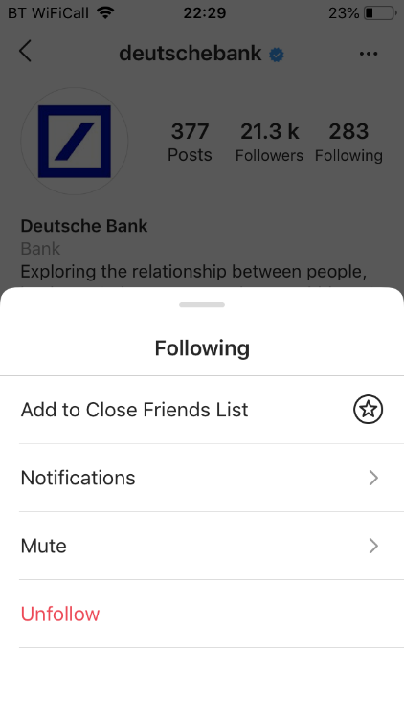
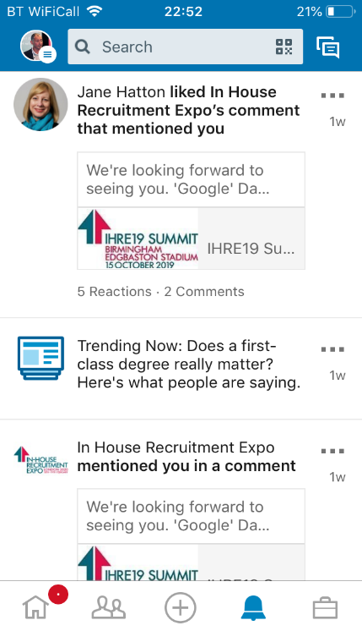
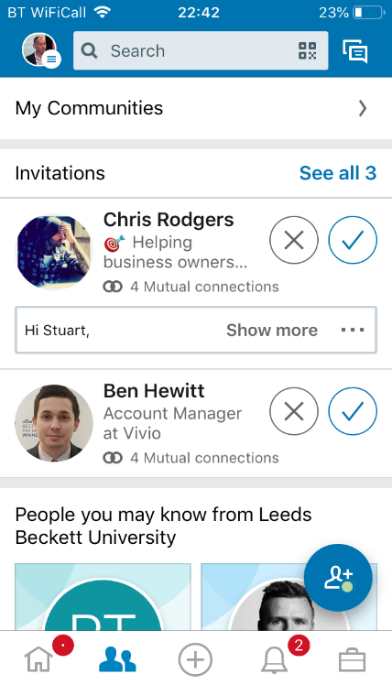
Share & Engage: Practical Tips
Follow company profiles (Instagram – add notifications)
Connect / follow colleagues & other advocates (LinkedIn Location Connect & Teammates
Respond swiftly to tags, mentions & notifications
Follow / subscribe to company branded hashtags
Notes:
Note: as per slide, some general hints & tips for advocates to track & engage with company / campaign / advocate content.

Slide 17
Level 3: Content Creation
Characteristics:
Look for ‘story’ opportunities
Comfortable creating content (text, image, video & Stories?)
Consistent / branded hashtags
Notes:
Level 3 – Content Creator
To achieve the aim of Employee Advocacy 2.0 you must be willing to give your employees the permission, confidence and skills to create and share their own workplace stories. There are a number of aspects to this:
Look for ‘story’ opportunities – you will probably want to set guidelines and provide good examples of what makes a good ‘story’ and what the key messages are that you hope to be conveyed. Of course, it needs to be authentic and not contrived, so your advocates remain the creatives and own the narrative – but providing a few guidelines will help them stay on track.
Comfortable creating content (across different networks and formats) – some of your advocates might be self-taught experts at sharing their social content (and you definitely want to harness those skills!), but they may be less comfortable sharing with a corporate of professional message in mind. Train them on both the practical skills needed for each network they’ll be using, but also train them to embed your hashtag strategies, post layouts, and maybe a few basic do’s and don’t’s.
Hashtag Strategy – it’s vital that any content shared contains the relevant hashtags (so it can be found easily and joins the wider conversation of content created under that label / tag). This might be really simple, like #LifeAtNext, or you might have a more fragmented strategy with different tags for different audiences, e.g. #ITatNext or #RetailAtNext

Slide 18
Training Your Advocates…
Story Ideation
Workplace Stories
What makes a good story
Content Capture
Smartphone Camera
On-The-Go vs Planned
Content Creation
Editing & Producing
Platform ‘best-practice’
Who are your ADVOCATES?
Notes:
Notes – some training ideas to cover.
Q: Who are your advocates? Recruiters should be brand advocates as part of their role, but many fail to complete the full journey. Similarly, sales people tend to have strong networks and familiarity with posting content, but not always with employer brand messages in mind. Your leadership team should be your biggest advocates, but become more wary of sharing publicly as they reach senior roles.
Some organisations will choose to hand-pick those people they want to invite to an advocacy programme, while others will throw it open to volunteers across the business. Whichever approach you choose – be sure to support those people with the skills and confidence to create and share their own workplace stories.

Slide 19
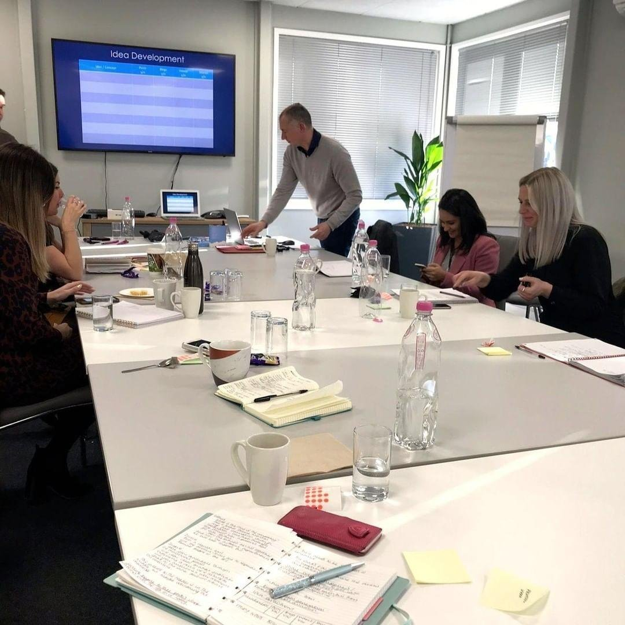
InSource Talent Training
Content Marketing for Recruiters
An in-depth at the in-house recruiter's role as 'brand ambassador' and how they can use CONTENT to build pipelines of future talent on social media.
Social Media for Recruitment
A comprehensive review of how to use the leading social networks (from LinkedIn to Snapchat!) for talent sourcing, employer branding & candidate engagement.
The Modern In-House Recruiter
A look at the modern hiring process, and how recruiters
can up-skill & up-lift themselves to provide an expert-level, in-house recruitment service.
Onsite or offsite
Full-day or half-day
Recruiter workshops
Advocate workshops

Slide 20
STUART JONES
InSource Talent
07872 990 714
stuart@insourcetalent.co.uk

